Slide 1


CSCE 5610
Computer System Architecture
Instruction Level Parallelism

Slide 2
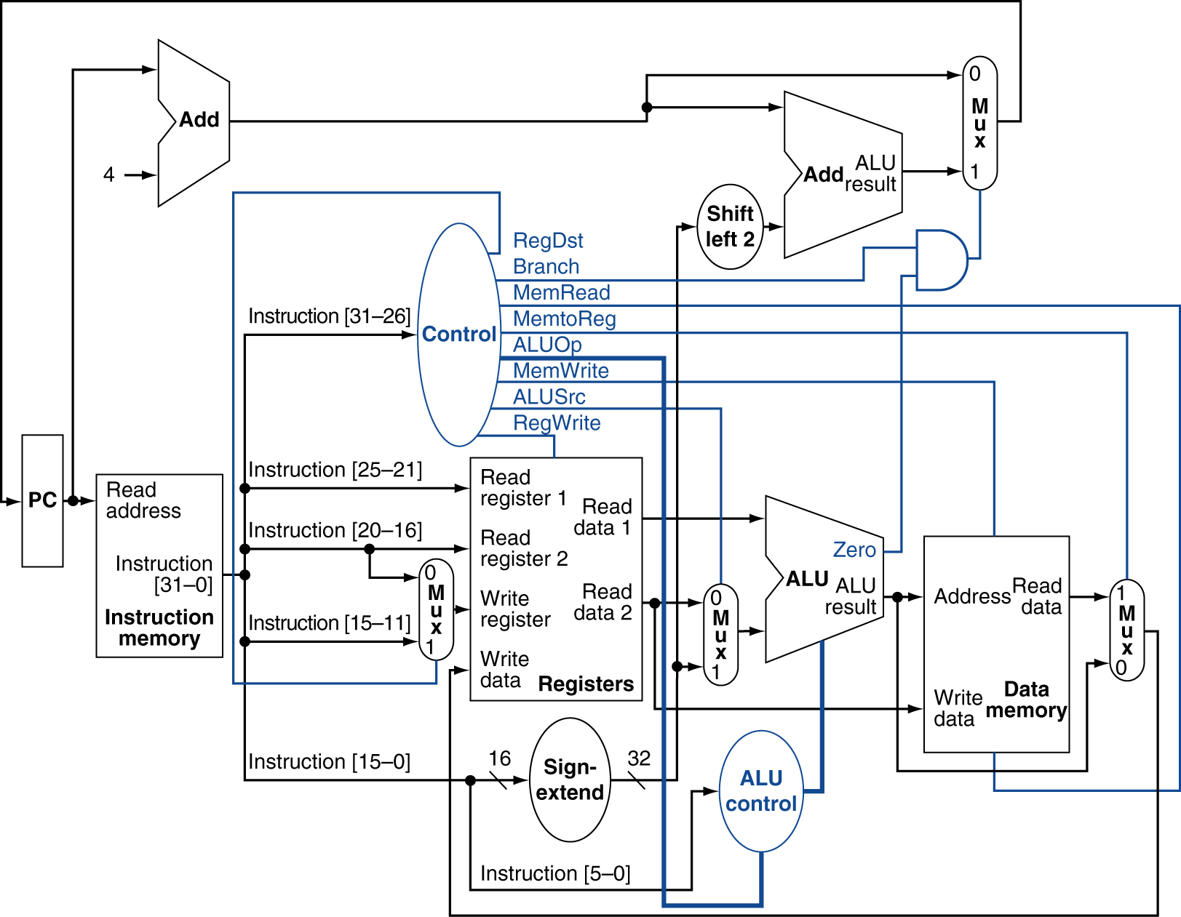
Single-Cycle implementation
Why Single-Cycle implementation is not used today?
Requires the same length for every instruction
The clock cycle is determined by the longest possible path (worst case scenario!)
The load instruction (lw) that uses five functional units in series:
Inst. Mem → Reg. File → ALU→ Data Mem. → Reg. File

Slide 3
A Relevant Question
Assuming you’ve got:
— One washer (takes 30 minutes)
— One drier (takes 40 minutes)
— One “folder” (takes 20 minutes)
It takes 90 minutes to wash, dry, and fold 1 load of laundry.
— How long does 4 loads take?

Slide 4
The Slow Way
6 PM
7
8
9
10
11
Midnight
Time
30 40 20 30 40 20 30 40 20 30 40 20
If each load is done sequentially it takes 6 hours

Slide 5

Laundry Pipelining
Start each load as soon as possible
— Overlap loads
6 PM
7 8 9
10
11
Midnight
Time
30 40 40 40 40 20
Pipelined laundry takes 3.5 hours

Slide 6
Instruction Execution Review
Executing a MIPS instruction can take up to five steps.
Step | Name | Description
Instruction Fetch | IF | Read an instruction from memory.
Instruction Decode | ID | Read source registers and generate control signals.
Execute | EX | Compute an R-type result or a branch outcome.
Memory | MEM | Read or write the data memory.
Writeback | WB | Store a result in the destination register.
However, as we saw, not all instructions need all five steps.
Instruction | Steps required
beq | IF | ID | EX
R-type | IF | ID | EX |  | WB
sw | IF | ID | EX | MEM
lw | IF | ID | EX | MEM | WB

Slide 7
Single-cycle Datapath Diagram
0
M
u
PC
Add
x
1
4
Add
1ns
RegWrite
Shift left 2
PCSrc
2ns
MemWrite
Read Instruction address [31-0]
Instruction memory
I [25 - 21]
2ns
ALU
Zero
Result
MemToReg
Read
register 1
Read register 2
Write register
Write data
Read data 1
Read Read
1
M
u
I [20 - 16]
address data Write
address
Data
0
M
u x
1
Read data 2
Registers
0
M
u x
1
x
0
2ns
Write data
memory
I [15 - 11]
ALUOp
RegDst I [15 - 0]
ALUSrc
MemRead
Sign extend
How long does it take to execute each instruction?

Slide 8
Single-cycle Review
All five execution steps occur in one clock cycle.
This means the cycle time must be long enough to accommodate all the
steps of the most complex instruction—a “lw” in our instruction set.
If the register file has a 1ns latency and the memories and ALU have a 2ns latency, “lw” will require 8ns.
Thus all instructions will take 8ns to execute.
Each hardware element can only be used once per clock cycle.

Slide 9
Example: Instruction Fetch (IF)
Let’s quickly review how lw is executed in the single-cycle datapath.
We’ll ignore PC incrementing and branching for now.
In the Instruction Fetch (IF) step, we read the instruction memory.
RegWrite
Read Instruction address [31-0]
Instruction
memory
I [25 - 21]
MemWrite
MemToReg
Read register 1
Read register 2
Write register
Write data
Read data 1
ALU
Read Read
1
M
u
I [20 - 16]
Zero Result
address data Write
address
Data
0
M
u x
1
Read data 2
Registers
0
x
0
M
u x
1
Write data
memory
I [15 - 11]
ALUOp
RegDst I [15 - 0]
ALUSrc
MemRead
Sign extend

Slide 10
Instruction Decode (ID)
The Instruction Decode (ID) step reads the source registers from the register file.
RegWrite
Read Instruction address [31-0]
Instruction
memory
I [25 - 21]
MemWrite
MemToReg
Read register 1
Read register 2
Write register
Write data
Read data 1
ALU
Read Read
1
M
u
I [20 - 16]
Zero Result
address data Write
address
Data
0
M
u x
1
Read data 2
Registers
0
x
0
M
u x
1
Write data
memory
I [15 - 11]
ALUOp
RegDst I [15 - 0]
ALUSrc
MemRead
Sign extend

Slide 11
Execute (EX)
The third step, Execute (EX), computes the effective memory address from the source register and the instruction’s constant field.
RegWrite
Read Instruction address [31-0]
Instruction
memory
I [25 - 21]
MemWrite
MemToReg
Read register 1
Read register 2
Write register
Write data
Read data 1
ALU
Read Read
1
M
u
I [20 - 16]
Zero Result
address data Write
address
Data
0
M
u x
1
Read data 2
Registers
0
x
0
M
u x
1
Write data
memory
I [15 - 11]
ALUOp
RegDst I [15 - 0]
ALUSrc
MemRead
Sign extend

Slide 12
Memory (MEM)
The Memory (MEM) step involves reading the data memory, from the address computed by the ALU.
RegWrite
Read Instruction address [31-0]
Instruction
memory
I [25 - 21]
MemWrite
MemToReg
Read register 1
Read register 2
Write register
Write data
Read data 1
ALU
Read Read
1
M
u
I [20 - 16]
Zero Result
address data Write
address
Data
0
M
u x
1
Read data 2
Registers
0
x
0
M
u x
1
Write data
memory
I [15 - 11]
ALUOp
RegDst I [15 - 0]
ALUSrc
MemRead
Sign extend

Slide 13
Writeback (WB)
Finally, in the Writeback (WB) step, the memory value is stored into the destination register.
RegWrite
Read Instruction
address [31-0]
 |  | I [20 -
Instruction
memory
MemWrite
MemToReg
I [25 - 21]
Read register 1
Read register 2
Write register
Write data
Read data 1
ALU
Read Read
1
M
u
16]
Zero Result
address data Write
address
Data
0
M
u x
1
Read data 2
Registers
0
x
0
M
u x
1
Write data
memory
I [15 - 11]
ALUOp
RegDst I [15 - 0]
ALUSrc
MemRead
Sign extend

Slide 14
A Bunch of Lazy Functional Units
Notice that each execution step uses a different functional unit.
In other words, the main units are idle for most of the 8ns cycle!
The instruction RAM is used for just 2ns at the start of the cycle.
Registers are read once in ID (1ns), and written once in WB (1ns).
The ALU is used for 2ns near the middle of the cycle.
Reading the data memory only takes 2ns as well.
That’s a lot of hardware sitting around doing nothing.

Slide 15
Putting Those Slackers to Work
We shouldn’t have to wait for the entire instruction to complete before we can reuse the functional units.
For example, the instruction memory is free in the Instruction Decode step as shown below, so...
Idle
Instruction Decode (ID)
RegWrite
Read Instruction address [31-0]
Instruction memory
I [25 - 21]
MemWrite
MemToReg
Read register 1
Read register 2
Write register
Write data
Read data 1
ALU
Read Read
1
M
u
I [20 - 16]
Zero Result
address data Write
address
Data
0
M
u x
1
Read data 2
Registers
0
x
0
M
u x
1
Write
data
memory
I [15 - 11]
ALUOp
RegDst I [15 - 0]
ALUSrc
MemRead
Sign extend

Slide 16
Decoding and Fetching Together
Why don’t we go ahead and fetch the next instruction while we’re decoding the first one?
Fetch 2nd
Decode 1st instruction
RegWrite
Read Instruction address [31-0]
Instruction memory
I [25 - 21]
MemWrite
MemToReg
Read register 1
Read register 2
Write register
Write data
Read data 1
ALU
Read Read
1
M
u
I [20 - 16]
Zero Result
address data Write
address
Data
0
M
u x
1
Read data 2
Registers
0
x
0
M
u x
1
Write
data
memory
I [15 - 11]
ALUOp
RegDst I [15 - 0]
ALUSrc
MemRead
Sign extend

Slide 17
Executing, Decoding and Fetching
Similarly, once the first instruction enters its Execute stage, we can go ahead and decode the second instruction.
But now the instruction memory is free again, so we can fetch the third instruction!
Fetch 3rd Execute 1st
Decode 2nd
RegWrite
Read Instruction address [31-0]
Instruction memory
I [25 - 21]
MemWrite
MemToReg
Read register 1
Read register 2
Write register
Write data
Read data 1
ALU
Read Read
1
M
u
I [20 - 16]
Zero Result
address data Write
address
Data
0
M
u x
1
Read data 2
Registers
0
x
0
M
u x
1
Write
data
memory
I [15 - 11]
ALUOp
RegDst I [15 - 0]
ALUSrc
MemRead
Sign extend

Slide 18
Break Datapath into 5 Stages
Each stage has its own functional units.
Each stage can execute in 2ns
IF
ID
EXE
MEM
WB
RegWrite
Read Instruction address [31-0]
Instruction memory
I [25 - 21]
MemWrite
MemToReg
Read register 1
Read register 2
Write register
Write data
Read data 1
ALU
Read Read
1
M
u
I [20 - 16]
Zero Result
address data Write
address
Data
0
M
u x
1
Read data 2
Registers
0
x
0
M
u x
1
Write
data
memory
I [15 - 11]
ALUOp
RegDst I [15 - 0]
ALUSrc
MemRead
Sign extend
2ns
2ns
2ns
2ns

Slide 19
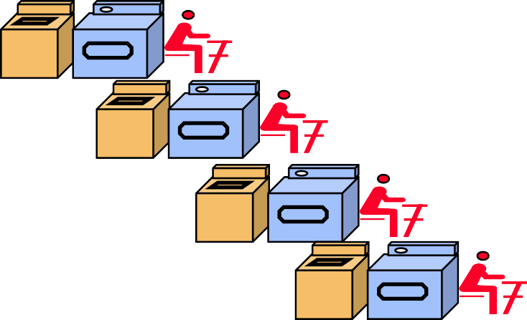
Pipelining Loads
Clock cycle 5
1
2
3
4
6
7
8
9
lw $t0, 4($sp)
lw $t1, 8($sp) lw $t2, 12($sp) lw $t3, 16($sp) lw $t4, 20($sp)
IF | ID | EX | MEM | WB
 | IF | ID | EX | MEM | WB
 |  | IF | ID | EX | MEM | WB
 |  |  | IF | ID | EX | MEM | WB
 |  |  |  | IF | ID | EX | MEM | WB
6 PM
7
8
9
Time
30 40 40 40 40 20

Slide 20
A Pipeline Diagram
Clock cycle 5
1
2
3
4
6
7
8
9
lw $t0, 4($sp)
sub $v0, $a0, $a1 and $t1, $t2, $t3
or $s0, $s1, $s2 add $sp, $sp, -4
A pipeline diagram shows the execution of a series of instructions.
The instruction sequence is shown vertically, from top to bottom.
Clock cycles are shown horizontally, from left to right.
Each instruction is divided into its component stages. (We show five
stages for every instruction, which will make the control unit easier.)
This clearly indicates the overlapping of instructions. For example, there are three instructions active in the third cycle above.
The “lw” instruction is in its Execute stage.
Simultaneously, the “sub” is in its Instruction Decode stage.
Also, the “and” instruction is just being fetched.
IF | ID | EX | MEM | WB
 | IF | ID | EX | MEM | WB
 |  | IF | ID | EX | MEM | WB
 |  |  | IF | ID | EX | MEM | WB
 |  |  |  | IF | ID | EX | MEM | WB

Slide 21
Pipeline Terminology
Clock cycle 5
1
2
3
4
6
7
8
9
lw $t0, 4($sp)
sub $v0, $a0, $a1 and $t1, $t2, $t3
or $s0, $s1, $s2 add $sp, $sp, -4
filling full emptying
The pipeline depth is the number of stages—in this case, five.
In the first four cycles here, the pipeline is filling, since there are unused
functional units.
In cycle 5, the pipeline is full. Five instructions are being executed simultaneously, so all hardware units are in use.
In cycles 6-9, the pipeline is emptying.
IF | ID | EX | MEM | WB
 | IF | ID | EX | MEM | WB
 |  | IF | ID | EX | MEM | WB
 |  |  | IF | ID | EX | MEM | WB
 |  |  |  | IF | ID | EX | MEM | WB

Slide 22
Pipelining Performance
Clock cycle 5
1
2
3
4
6
7
8
9
lw $t0, 4($sp)
lw $t1, 8($sp) lw $t2, 12($sp) lw $t3, 16($sp) lw $t4, 20($sp)
IF | ID | EX | MEM | WB
 | IF | ID | EX | MEM | WB
 |  | IF | ID | EX | MEM | WB
 |  |  | IF | ID | EX | MEM | WB
 |  |  |  | IF | ID | EX | MEM | WB
filling
Execution time on ideal pipeline:
time to fill the pipeline + one cycle per instruction
N instructions -> 4 cycles + N cycles or (2N + 8) ns for 2ns clock period
Compare with other implementations:
Single Cycle: N cycles or 8N ns for 8ns clock period
How much faster is pipelining for N=1000 ?

Slide 23
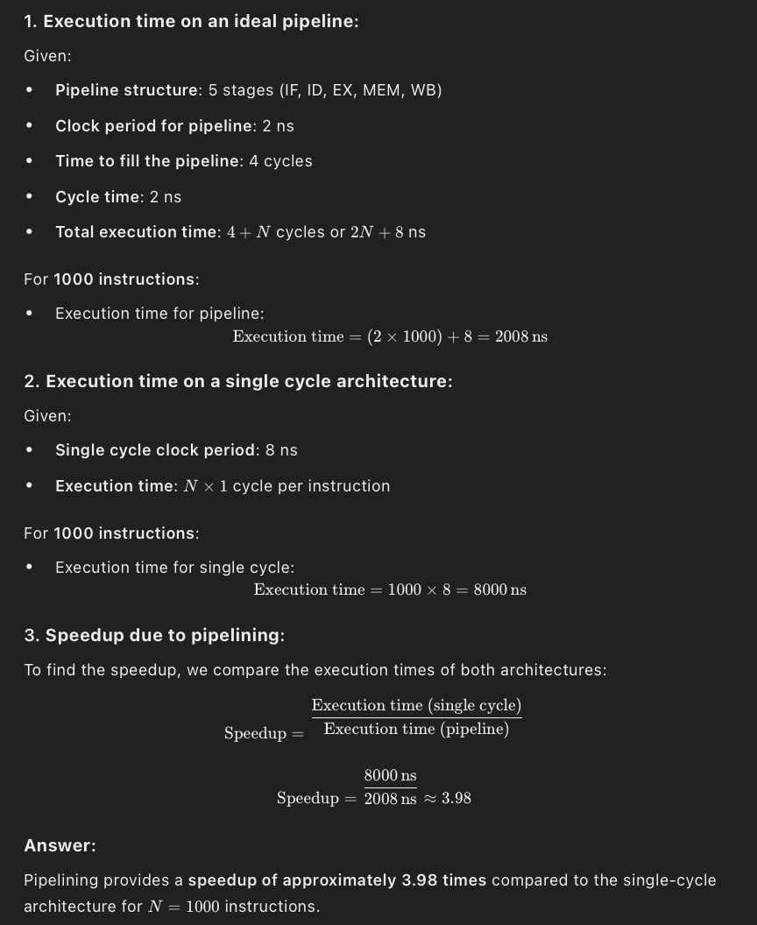

Slide 24
Pipelining Other Instruction Types
R-type instructions only require 4 stages: IF, ID, EX, and WB
— We don’t need the MEM stage
What happens if we try to pipeline loads with R-type instructions?
Clock cycle
5
1
2
3
4
6
7
8
9
add $sp, $sp, -4 sub $v0, $a0, $a1 lw $t0, 4($sp)
or $s0, $s1, $s2 lw $t1, 8($sp)
IF | ID | EX | WB
 | IF | ID | EX | WB
 |  | IF | ID | EX | MEM | WB
 |  |  | IF | ID | EX | WB
 |  |  |  | IF | ID | EX | MEM | WB

Slide 25
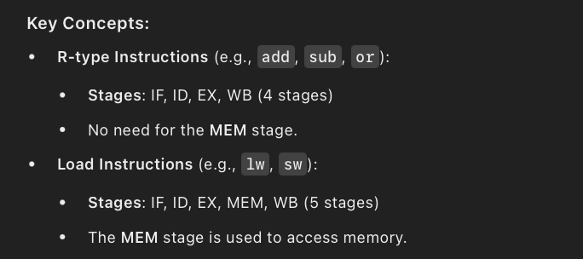
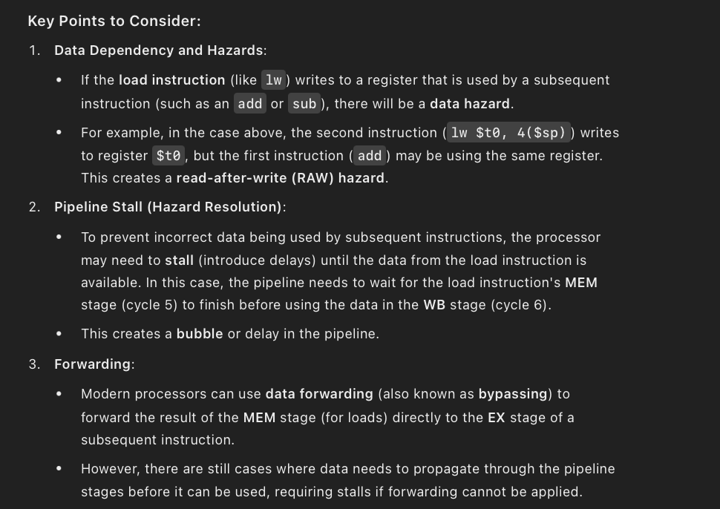

Slide 26
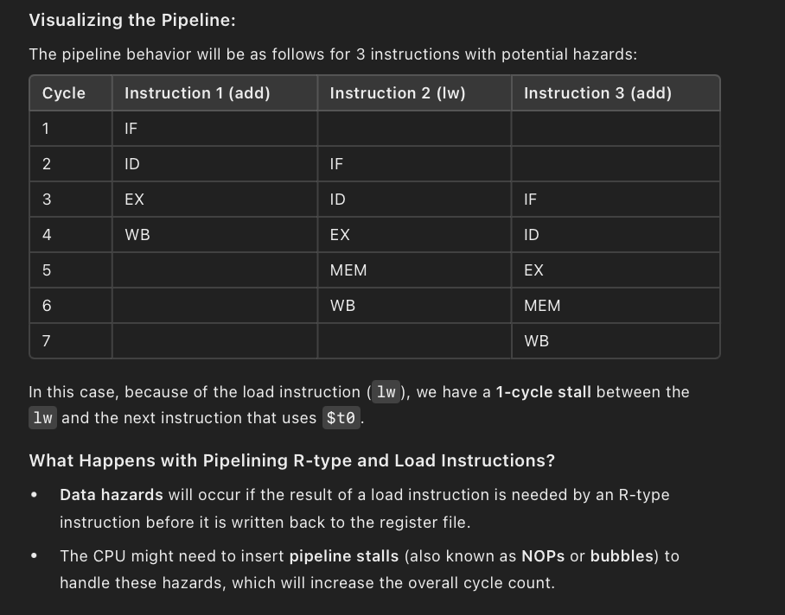
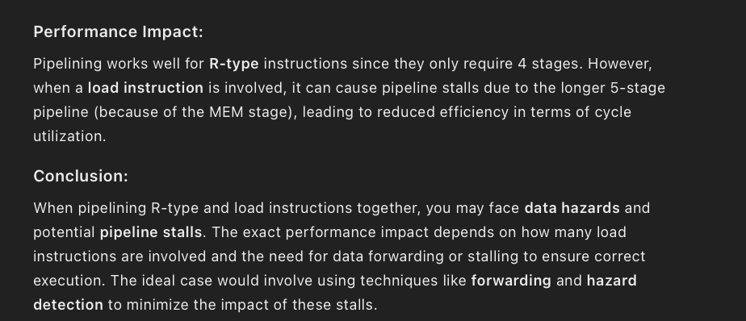

Slide 27
Important Observation
Each functional unit can only be used once per instruction
Each functional unit must be used at the same stage for all instructions. See the problem if:
Load uses Register File’s Write Port during its 5th stage
R-type uses Register File’s Write Port during its 4th stage
Clock cycle
5
1
2
3
4
6
7
8
9
add $sp, $sp, -4 sub $v0, $a0, $a1 lw $t0, 4($sp)
or $s0, $s1, $s2 lw $t1, 8($sp)
IF | ID | EX | WB
 | IF | ID | EX | WB
 |  | IF | ID | EX | MEM | WB
 |  |  | IF | ID | EX | WB
 |  |  |  | IF | ID | EX | MEM | WB

Slide 28
A solution: Insert NOP stages
Enforce uniformity
Make all instructions take 5 cycles.
Make them have the same stages, in the same order
Some stages will do nothing for some instructions
R-type | IF | ID | EX | NOP | WB
Clock cycle
5
1
2
3
4
6
7
8
9
add $sp, $sp, -4 sub $v0, $a0, $a1 lw $t0, 4($sp)
or $s0, $s1, $s2 lw $t1, 8($sp)
Stores and Branches have NOP stages, too…
IF | ID | EX | NOP | WB
 | IF | ID | EX | NOP | WB
 |  | IF | ID | EX | MEM | WB
 |  |  | IF | ID | EX | NOP | WB
 |  |  |  | IF | ID | EX | MEM | WB
store | IF | ID | EX | MEM | NOP
branch | IF | ID | EX | NOP | NOP

Slide 29
Pipeline Registers
We’ll add intermediate registers to our pipelined datapath too.
There’s a lot of information to save, however. We’ll simplify our diagrams by drawing just one big pipeline register between each stage.
The registers are named for the stages they connect.
IF/ID ID/EX EX/MEM MEM/WB
No register is needed after the WB stage, because after WB the instruction is done.

Slide 30
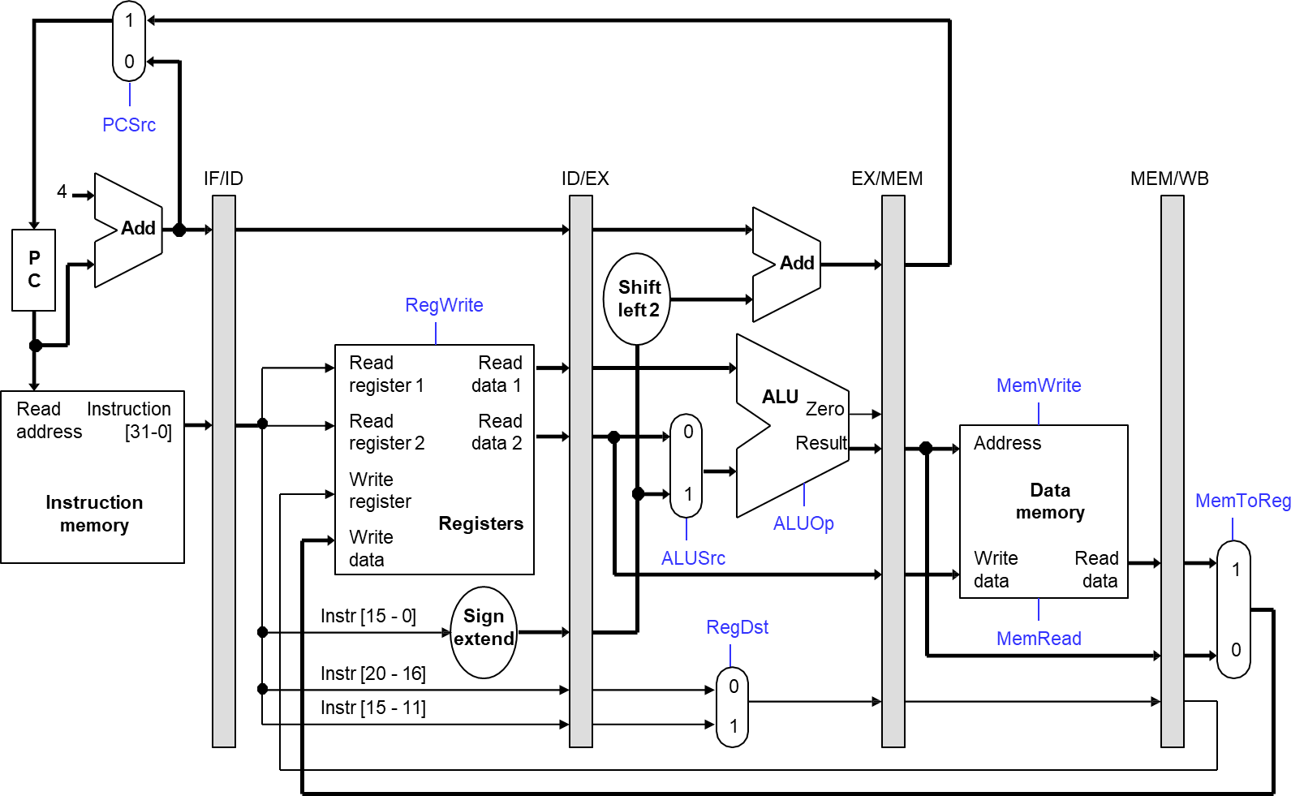
Pipelined Datapath

Slide 31
What about Control Signals?
The control signals are generated in the same way as in the single-cycle processor—after an instruction is fetched, the processor decodes it and produces the appropriate control values.
Control signals can be categorized by the pipeline stage that uses them.

Slide 32
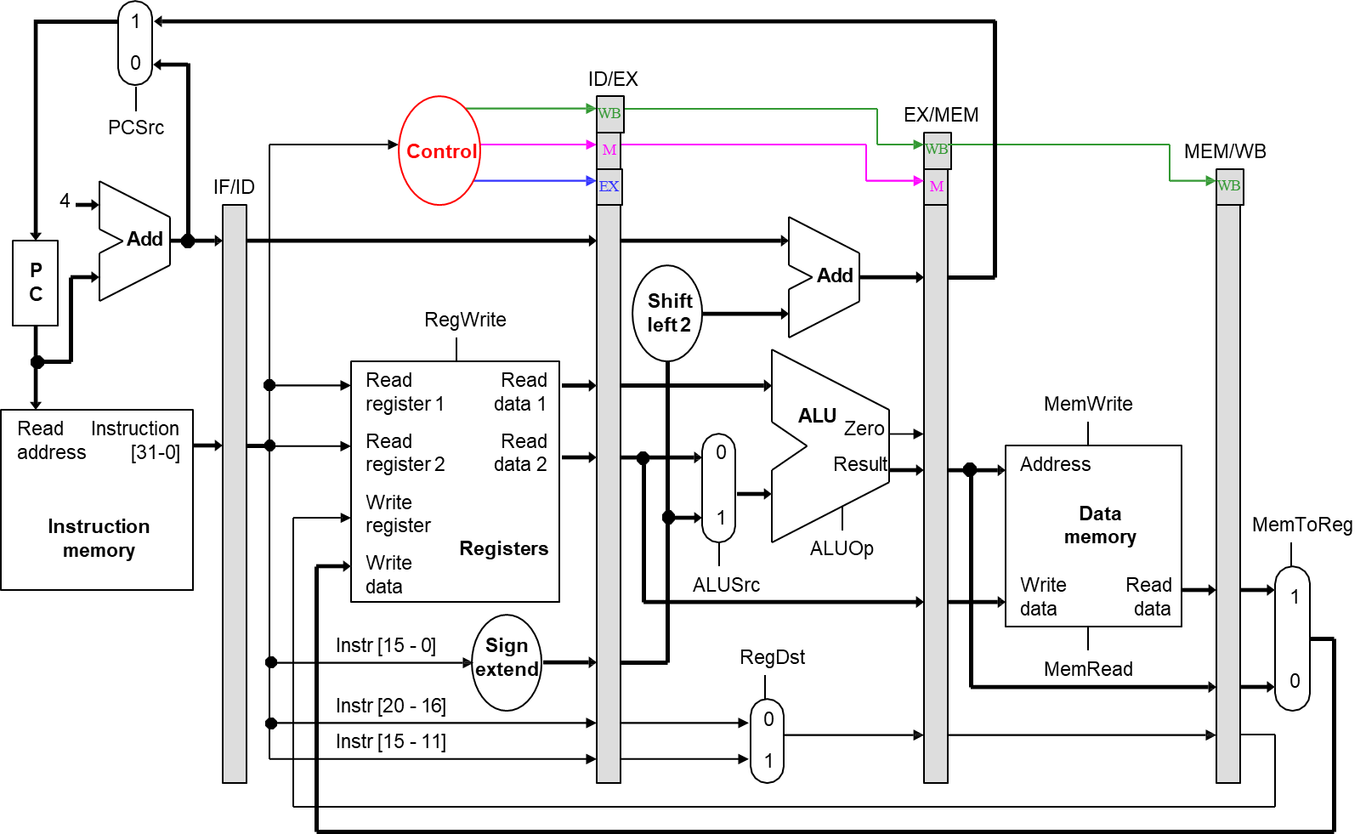
Pipelined Datapath and Control

Slide 33
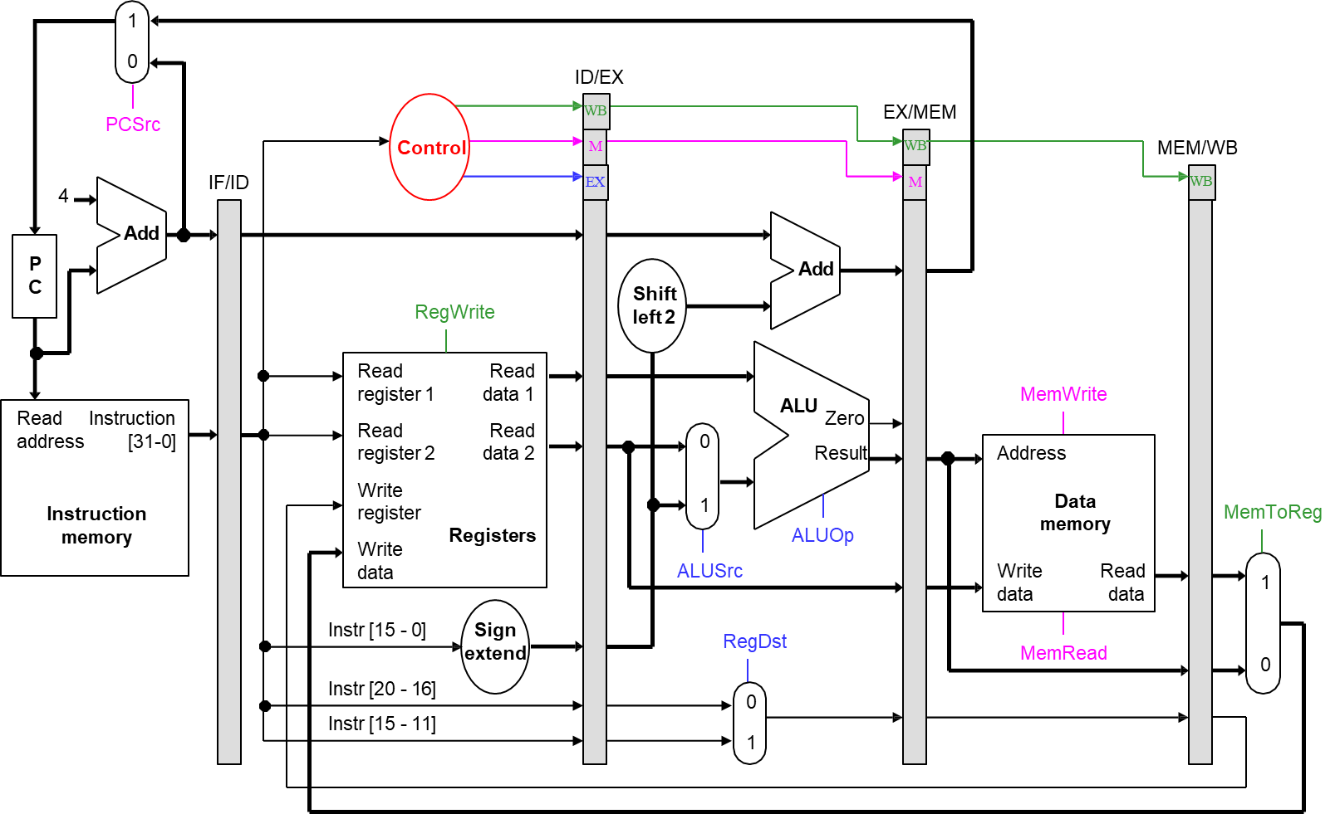
Pipelined Datapath and Control

Slide 34

An Example Execution Sequence
Here’s a sample sequence of instructions to execute.
1000: | lw | $8, | 4($29)
1004: | sub | $2, | $4, $5
1008: | and | $9, | $10, $11
1012: | or | $16, $17, $18
1016: | add | $13, $14, $0
addresses in
decimal
We’ll make some assumptions, just so we can show actual data values.
Each register contains its number plus 100. For instance, register $8
contains 108, register $29 contains 129, and so forth.
Every data memory location contains 99.
Our pipeline diagrams will follow some conventions.
An X indicates values that aren’t important, like the constant field of
an R-type instruction.
Question marks ??? indicate values we don’t know, usually resulting from instructions coming before and after the ones in our example.

Slide 35
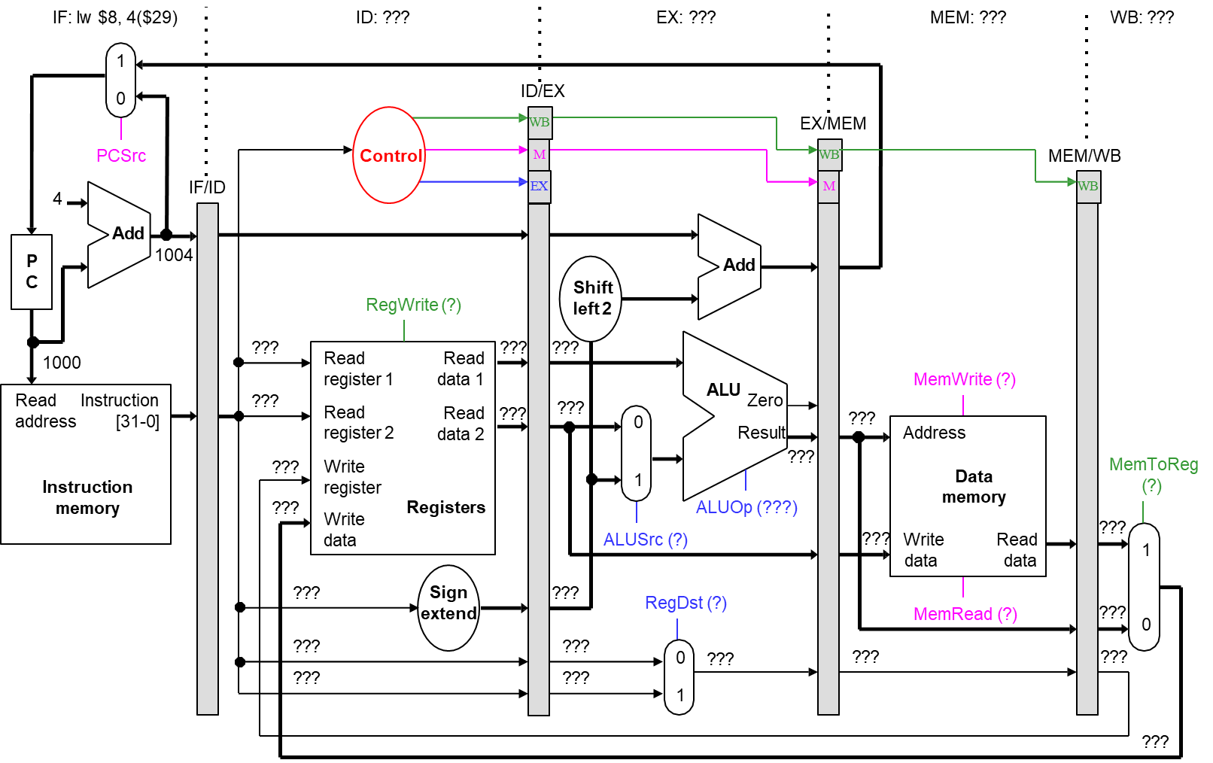
Cycle 1 (Filling)

Slide 36

Cycle 2

Slide 37

Cycle 3

Slide 38
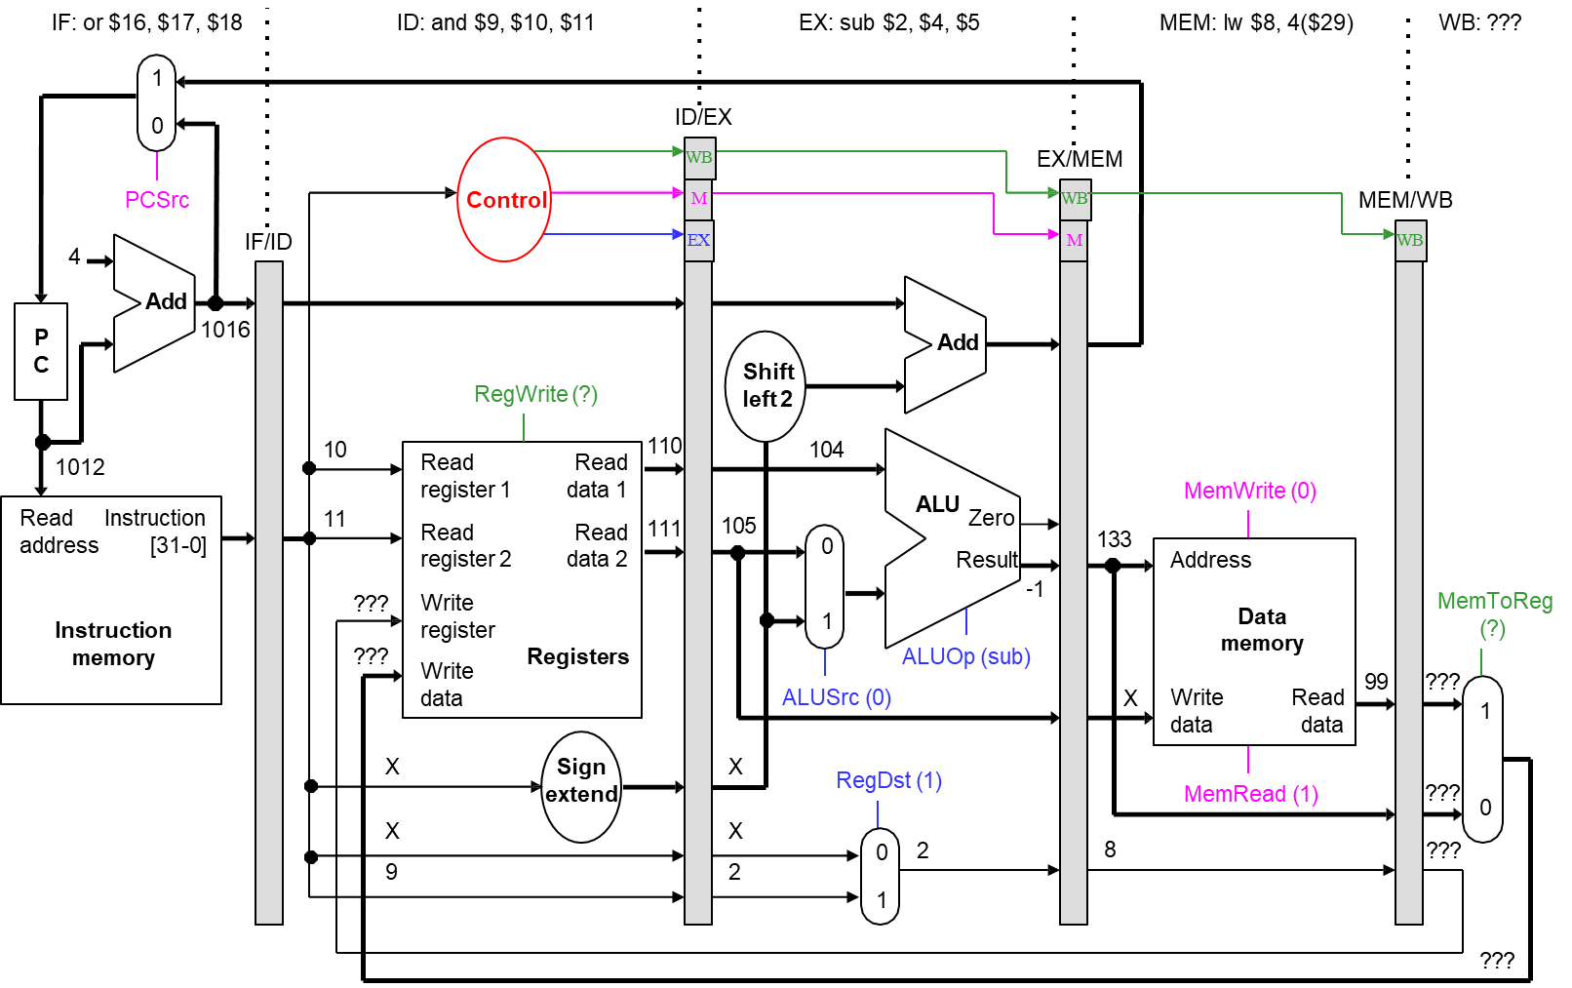
Cycle 4

Slide 39
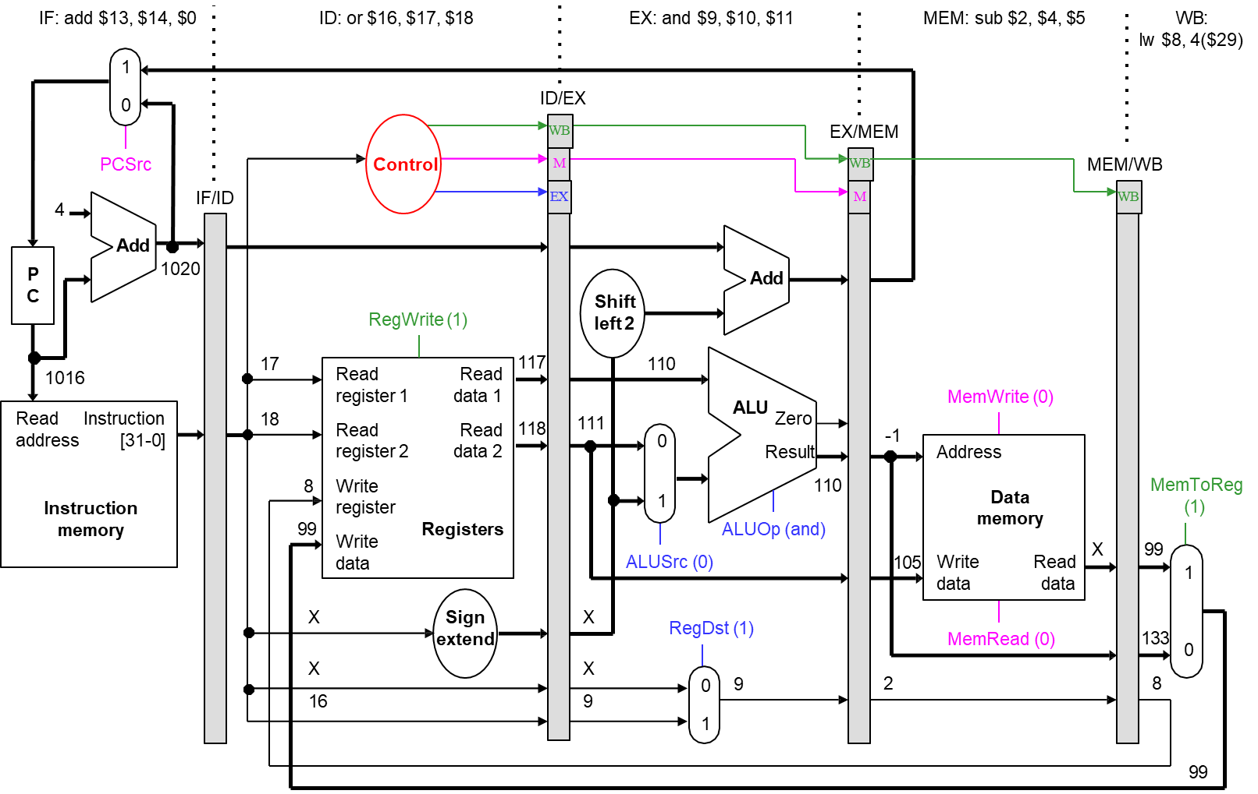
Cycle 5 (Full)

Slide 40
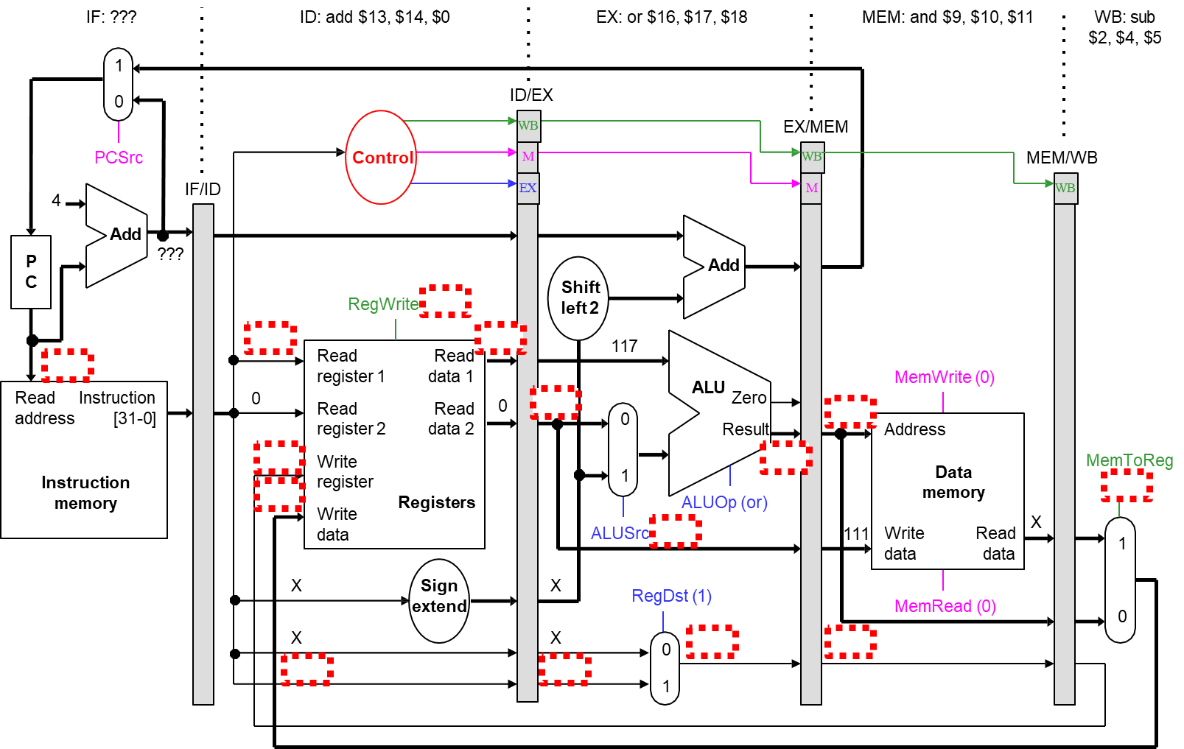
Cycle 6 (Emptying)

Slide 41
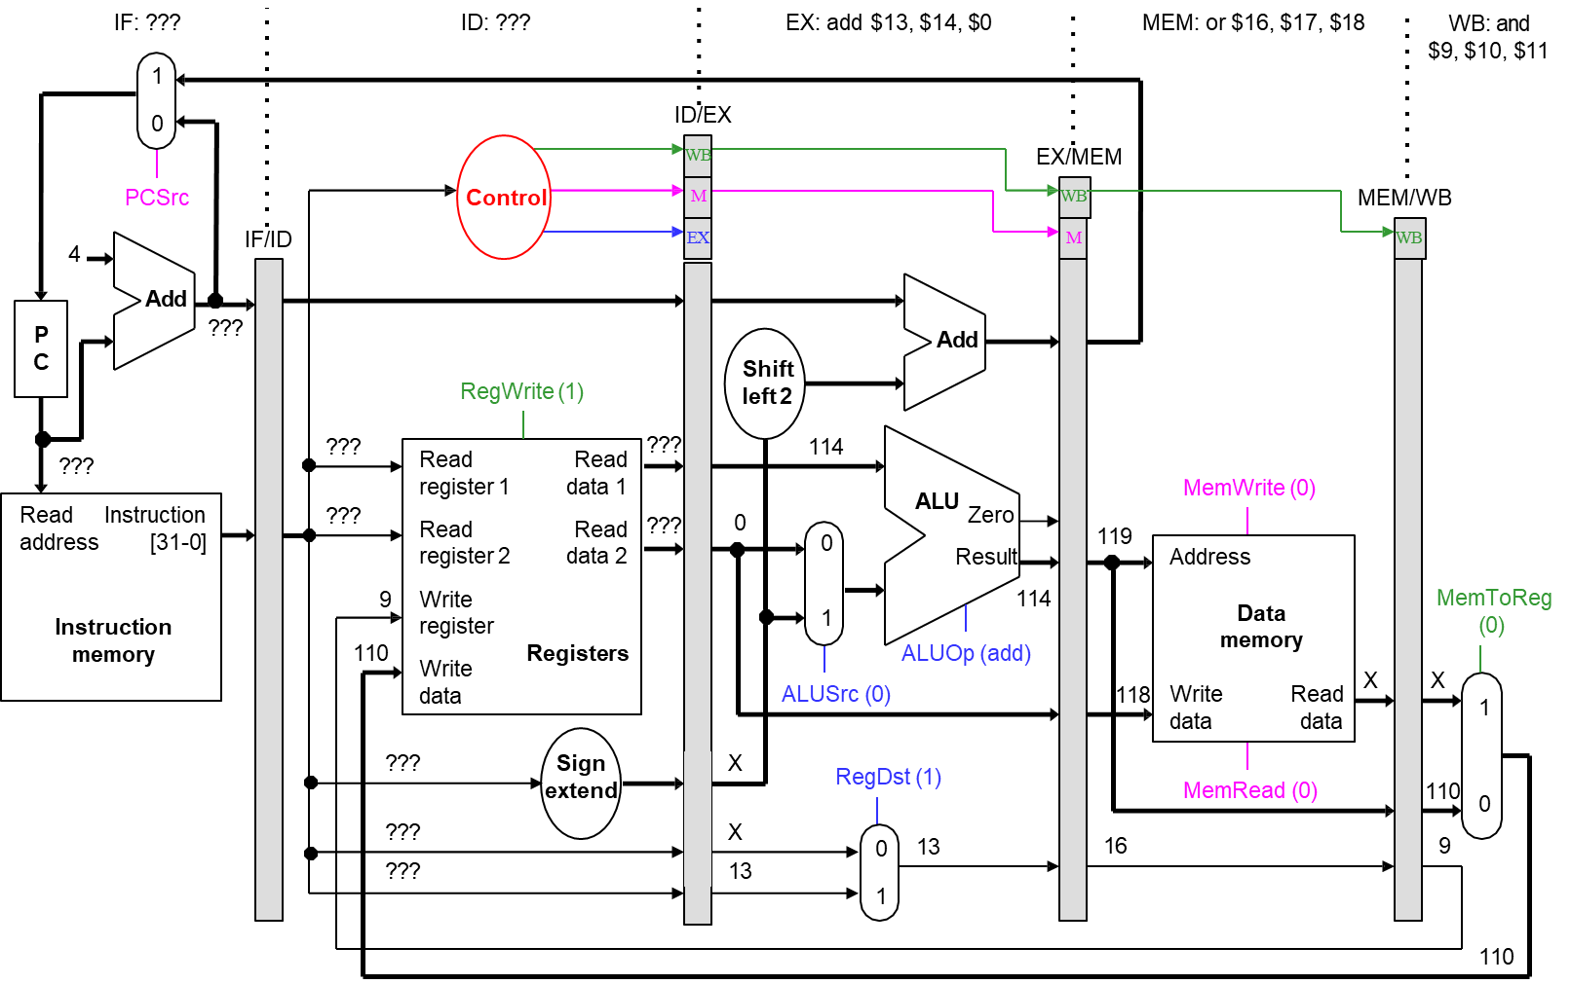
Cycle 7

Slide 42

Cycle 8

Slide 43

Cycle 9

Slide 44
That’s a lot of Diagrams There
Clock cycle 5
1
2
3
4
6
7
8
9
lw $t0, 4($sp)
sub $v0, $a0, $a1 and $t1, $t2, $t3
or $s0, $s1, $s2 add $t5, $t6, $0
Compare the last nine slides with the pipeline diagram above.
You can see how instruction executions are overlapped.
Each functional unit is used by a different instruction in each cycle.
The pipeline registers save control and data values generated in previous clock cycles for later use.
When the pipeline is full in clock cycle 5, all of the hardware units are utilized. This is the ideal situation, and what makes pipelined processors so fast.
IF | ID | EX | MEM | WB
 | IF | ID | EX | MEM | WB
 |  | IF | ID | EX | MEM | WB
 |  |  | IF | ID | EX | MEM | WB
 |  |  |  | IF | ID | EX | MEM | WB

Slide 45



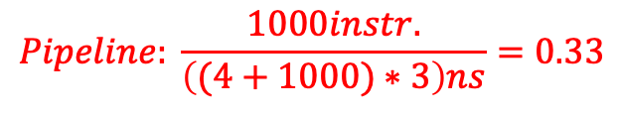
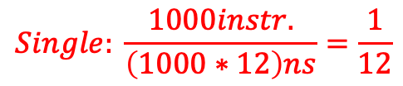


Performance Revisited
$$N=100000$$
$$T(S)=1000∗10$$
$$T(P)=(4+1000)∗2$$
Assuming the following functional unit latencies:
3ns 2ns 2ns 3ns
2ns
Inst mem
Reg Read
Data Mem
Reg Write
ALU
What is the cycle time of a single-cycle implementation?
What is its throughput (how many works/instr. finished in a unit of time)?
What is the cycle time of a ideal pipelined implementation?
What is its steady-state throughput?
$$Single: \frac{5instr.}{\left(5∗12\right)ns}=\frac{1}{12}$$
$$Pipeline: \frac{5instr.}{\left(9∗3\right)ns}=\frac{5}{27}$$
$$Pipeline: \frac{1000instr.}{\left((4+1000)∗3\right)ns}=0.33$$
$$Single: \frac{1000instr.}{\left(1000∗12\right)ns}=\frac{1}{12}$$
How much faster is pipelining?

Slide 46
Ideal Speedup
Clock cycle 5
1
2
3
4
6
7
8
9
lw $t0, 4($sp)
sub $v0, $a0, $a1 and $t1, $t2, $t3
or $s0, $s1, $s2 add $sp, $sp, -4
In our pipeline, we can execute up to five instructions simultaneously.
This implies that the maximum speedup is 5 times.
In general, the ideal speedup equals the pipeline depth.
Why was our speedup on the previous slide ―only "4" times?
The pipeline stages are imbalanced: a register file and ALU operations can be done in 2ns, but we must stretch that out to 3ns to keep the ID, EX, and WB stages synchronized with IF and MEM.
Balancing the stages is one of the many hard parts in designing a
pipelined processor.
IF | ID | EX | MEM | WB
 | IF | ID | EX | MEM | WB
 |  | IF | ID | EX | MEM | WB
 |  |  | IF | ID | EX | MEM | WB
 |  |  |  | IF | ID | EX | MEM | WB

Slide 47
The Pipelining Paradox
Clock cycle 5
1
2
3
4
6
7
8
9
lw $t0, 4($sp)
sub $v0, $a0, $a1 and $t1, $t2, $t3
or $s0, $s1, $s2 add $sp, $sp, -4
Pipelining does not improve the execution time of any single instruction. Each instruction here actually takes longer to execute than in a single- cycle datapath (15ns vs. 12ns)!
Instead, pipelining increases the throughput, or the amount of work done per unit time. Here, several instructions are executed together in each clock cycle.
The result is improved execution time for a sequence of instructions, such as an entire program.
IF | ID | EX | MEM | WB
 | IF | ID | EX | MEM | WB
 |  | IF | ID | EX | MEM | WB
 |  |  | IF | ID | EX | MEM | WB
 |  |  |  | IF | ID | EX | MEM | WB

